Slide 1

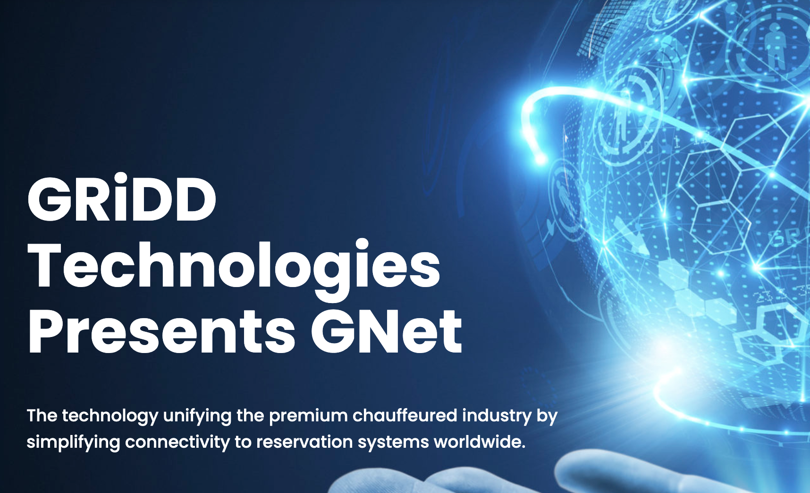
Introduction to GNet
GRiDD Technologies: A SaaS company based in Los Angeles, founded in 2011, specializing in creating solutions that integrate diverse transportation systems worldwide.
  GNet Overview: A powerful integration platform that facilitates the interconnection of dispatch systems globally, enhancing global operations without technology barriers.
  Significance of GNet Platform: Crucial for seamless global service provision in transportation, ensuring efficient operation across different technological systems.
  Reliability and Performance: Processes ten of thousands transactions daily with uptime SLA more than 99.99%

Slide 2
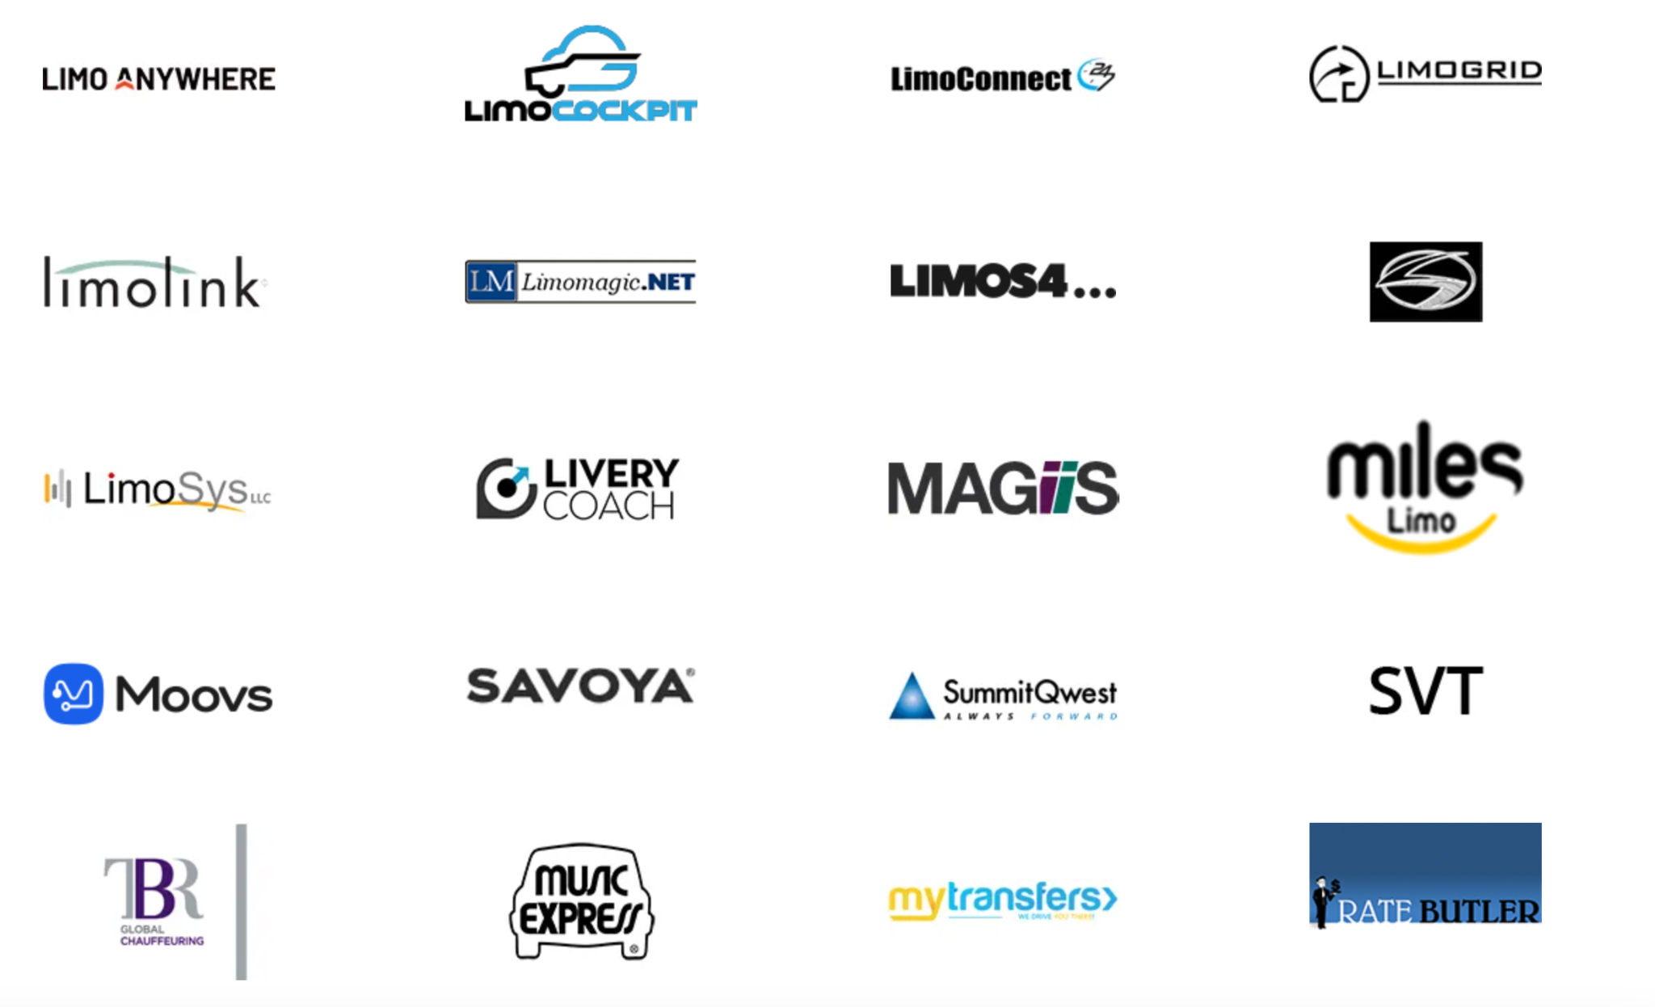
Features of GNet
Real-time Syncing: Trip, vehicle, driver, and status information are bi-directionally updated in real-time as changes occur.
  Integration Capabilities: Connects over 40 different software systems and reservation platforms, allowing seamless operation across various dispatch systems.
  GPS Location Services: Provides real-time GPS location of vehicles and trip status updates across all integrated systems.
Photo by Laurentiu Morariu on Unsplash

Slide 3
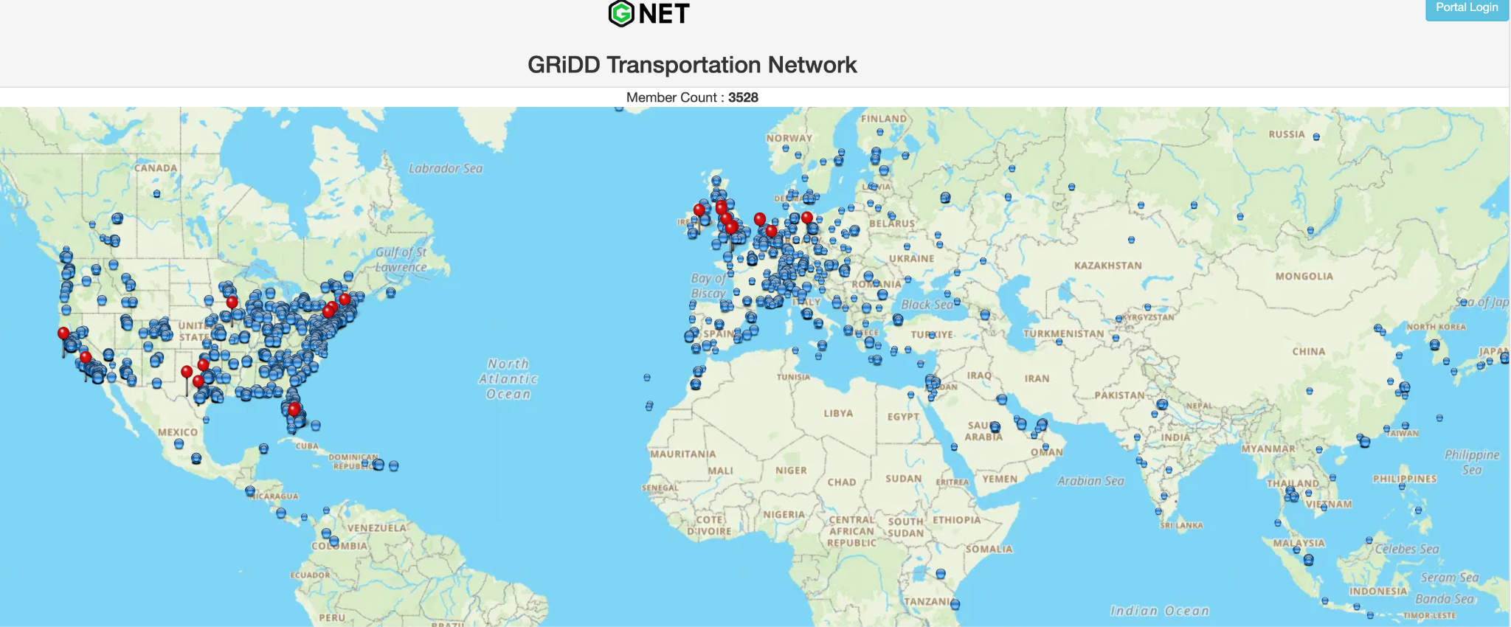
Global Reach and Connectivity
Extensive Network: Connects over 3,500 transportation companies across 55 countries and 5 continents, illustrating the extensive reach of GNet.
  Diverse Software Integration: Interconnects with more than 40 different software systems, including both commercial and proprietary reservation platforms.
  Continuous Expansion: Plans to include many more systems, further broadening the connectivity and capabilities of the GNet platform.

Slide 4
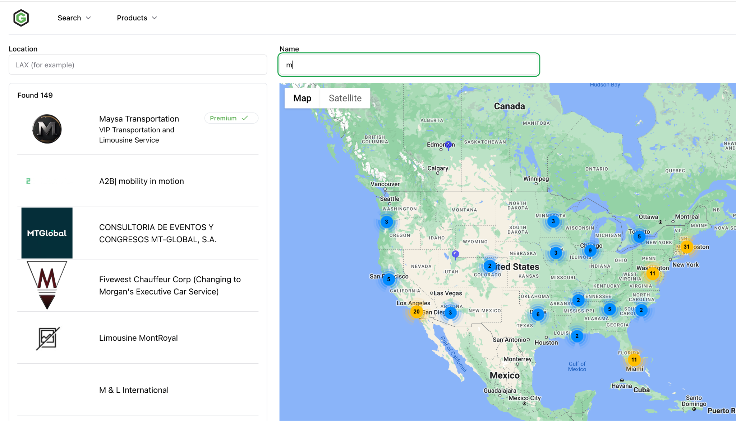
Benefits of Using GNet
Operational Efficiencies: GNet eliminates the need for manual processes such as emailing, faxing, or calling in reservations, significantly reducing repetitive tasks.
  Cost Reduction: By automating communications and integrations, GNet reduces operational costs and enhances productivity. (Approximately between $8 to $15 per reservation)
  Seamless User Experience: Customers continue to use their existing software, with all systems integrated seamlessly via GNet, ensuring a consistent and efficient user experience.

Slide 5
Detail Benefits
Ground Transportation Operators
Global Reach: Access international markets without local fleets.
Operational Efficiency: Automated updates and billing reduce costs and errors.
Real-Time Data: Immediate syncing of driver and trip status for smoother operations.
Travel Portals, Distributors, and Event Management
Enhanced Offerings: Provide global chauffeured services seamlessly.
Streamlined Reservations: Direct system integration for easy bookings and farmouts.
Customer Satisfaction: Reliable services enhance customer retention and reviews.
Software Vendors, Dispatch Services, and Apps
Seamless Integration: Connects with existing systems, no new software needed.
Increased Productivity: Automatic data syncing reduces system workload.
Market Competitiveness: Integration with GNet boosts appeal to potential clients.

Slide 6
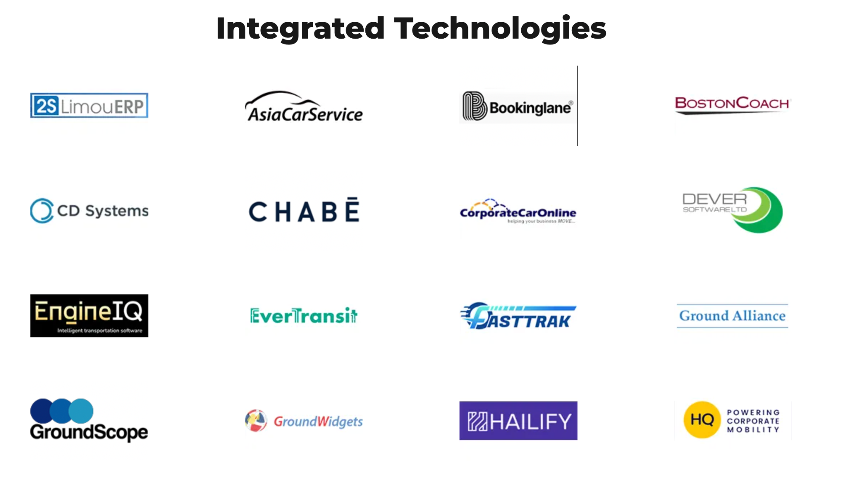
Conclusion
Impact on Global Transportation: GNet has fundamentally changed how transportation companies operate worldwide, connecting diverse systems to create a seamless global network.
  Continuous Improvement: GNet continues to expand its capabilities and connectivity, aiming to include more systems and cover more geographic locations.
  Vision for the Future: Positioned to become the primary source for worldwide premium chauffeured services, GNet is set to further enhance global travel channels.
  Contact us: info@grdd.net

